Slide 1
Your Name Here
My background: text here
My research interests:
text here
text here
Add a cool picture or animated GIF of your research here.

Slide 2
Your Name Here
My modeling project ideas:
idea
idea
My infrastructure / tool ideas:
idea
idea
A fun hobby or trivia: text here
Add a cool picture or animated GIF of your research here.

Slide 3
Example

Slide 4
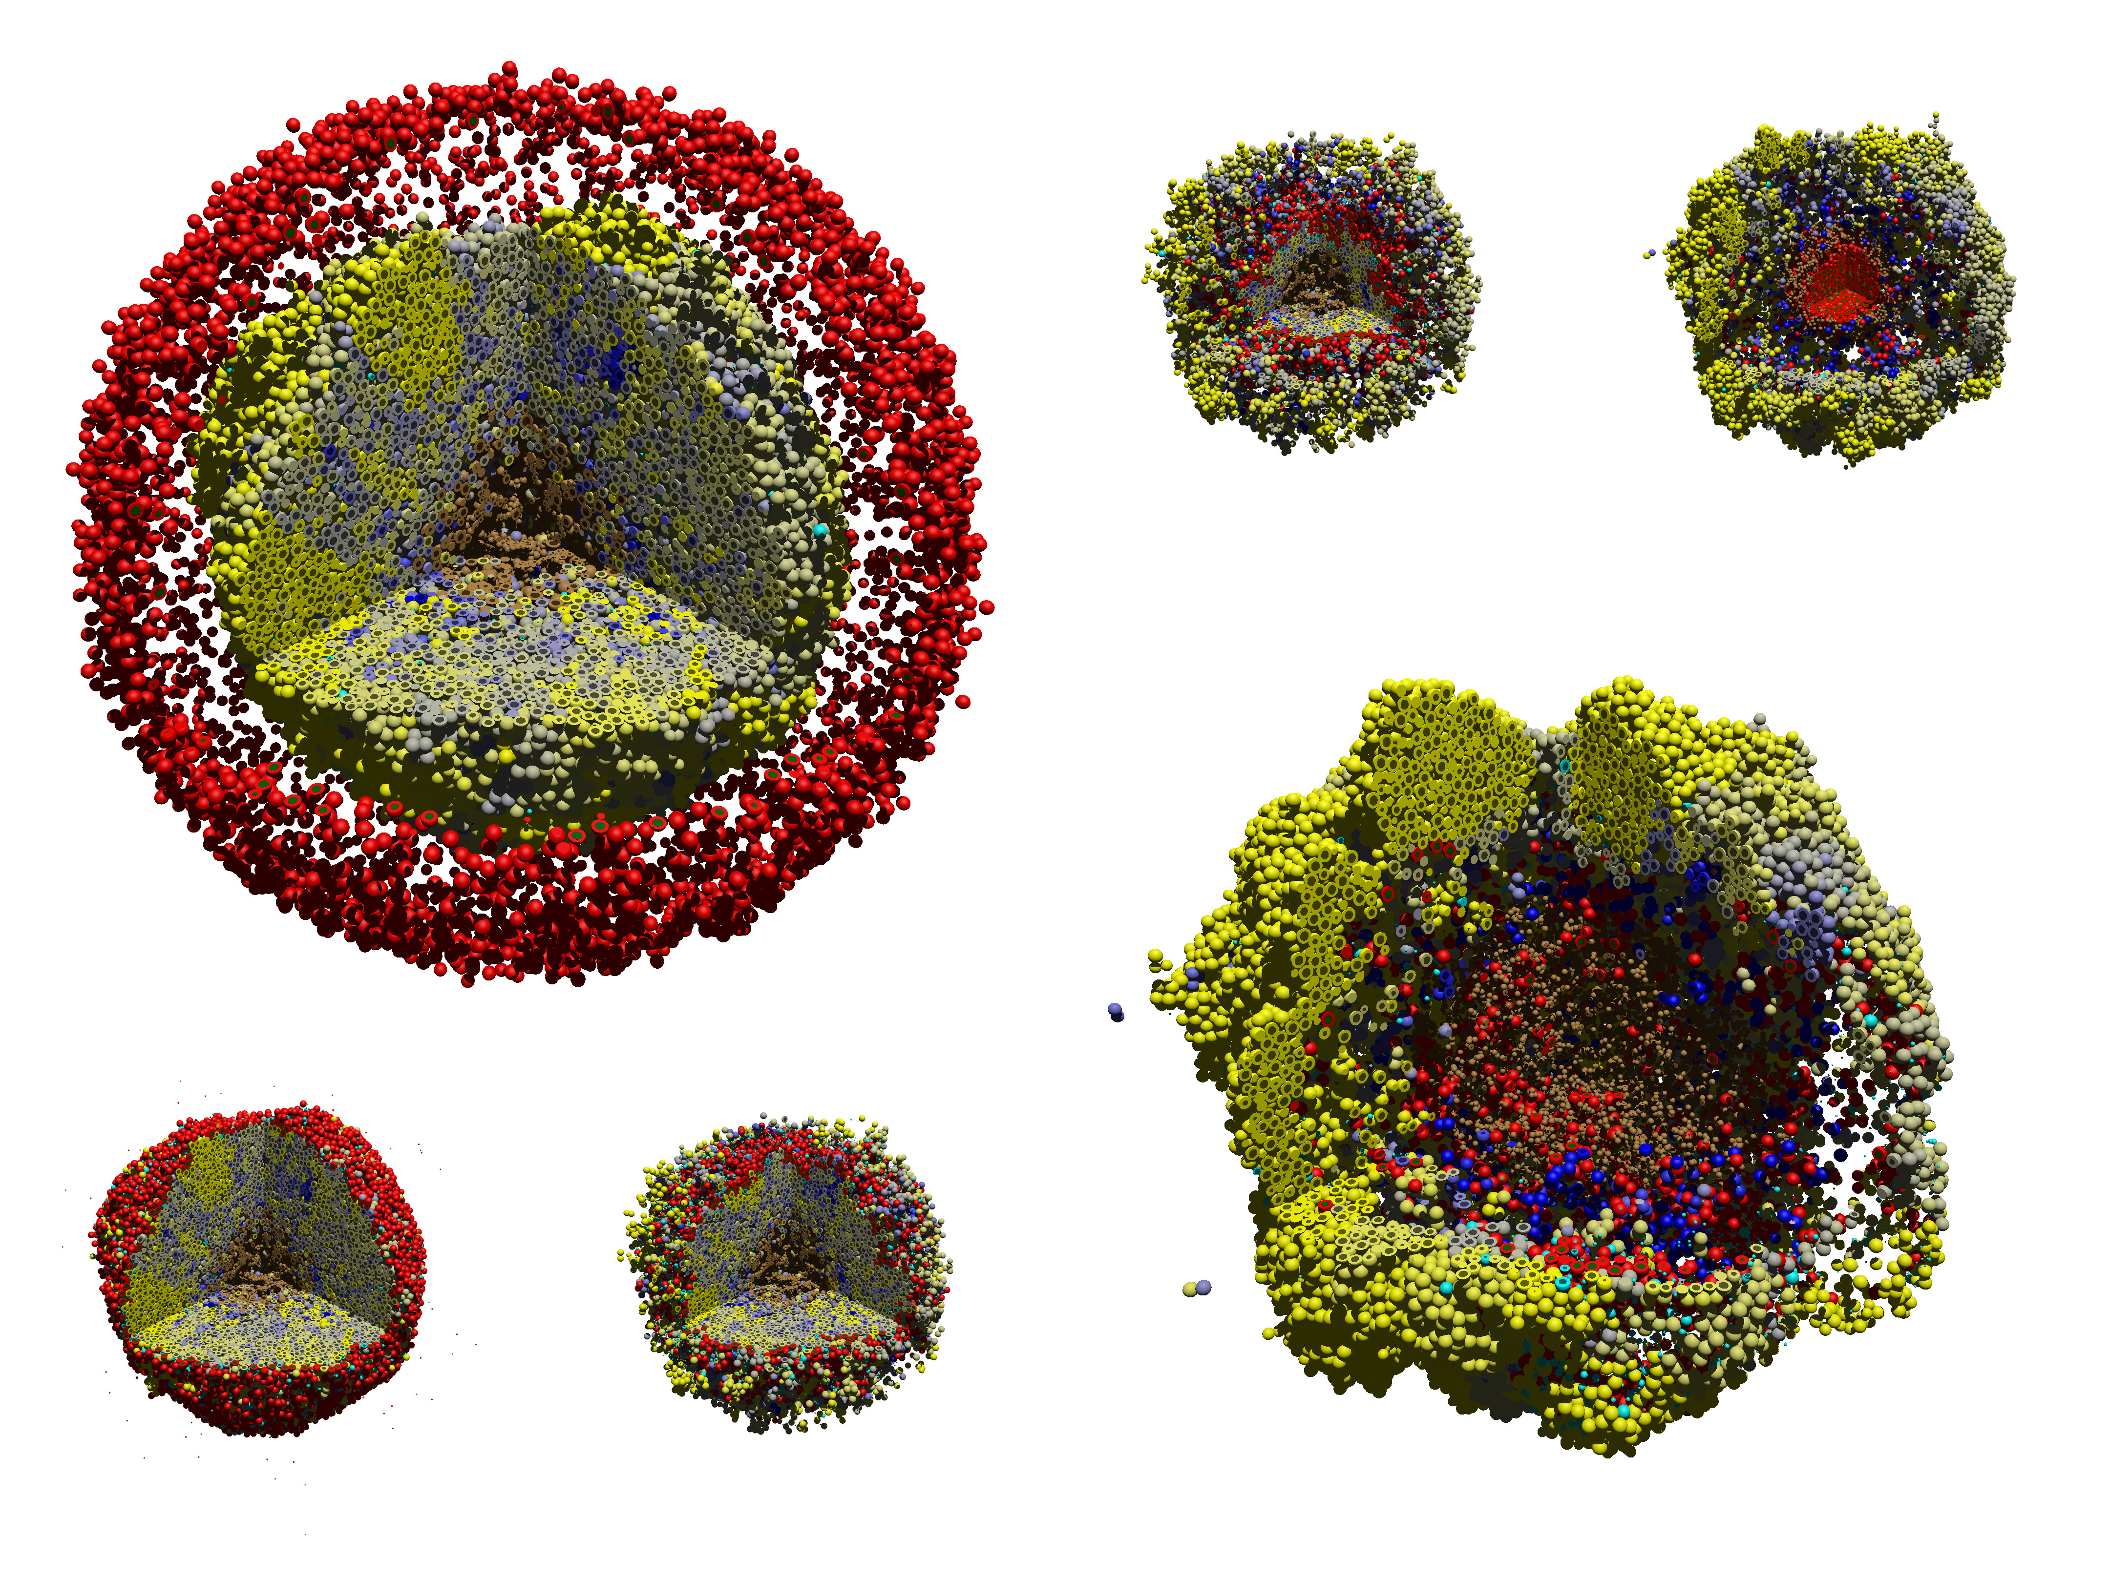
Paul Macklin
My background: Mathematician with training in mathematical biology and computational mathematics.
My research interests:
Agent-based modeling
open source and team science
Cancer simulations (especially immunotherapy)
Immunology / infectious diseases (COVID-19)
Cancer patient digital twins pilot project

Slide 5
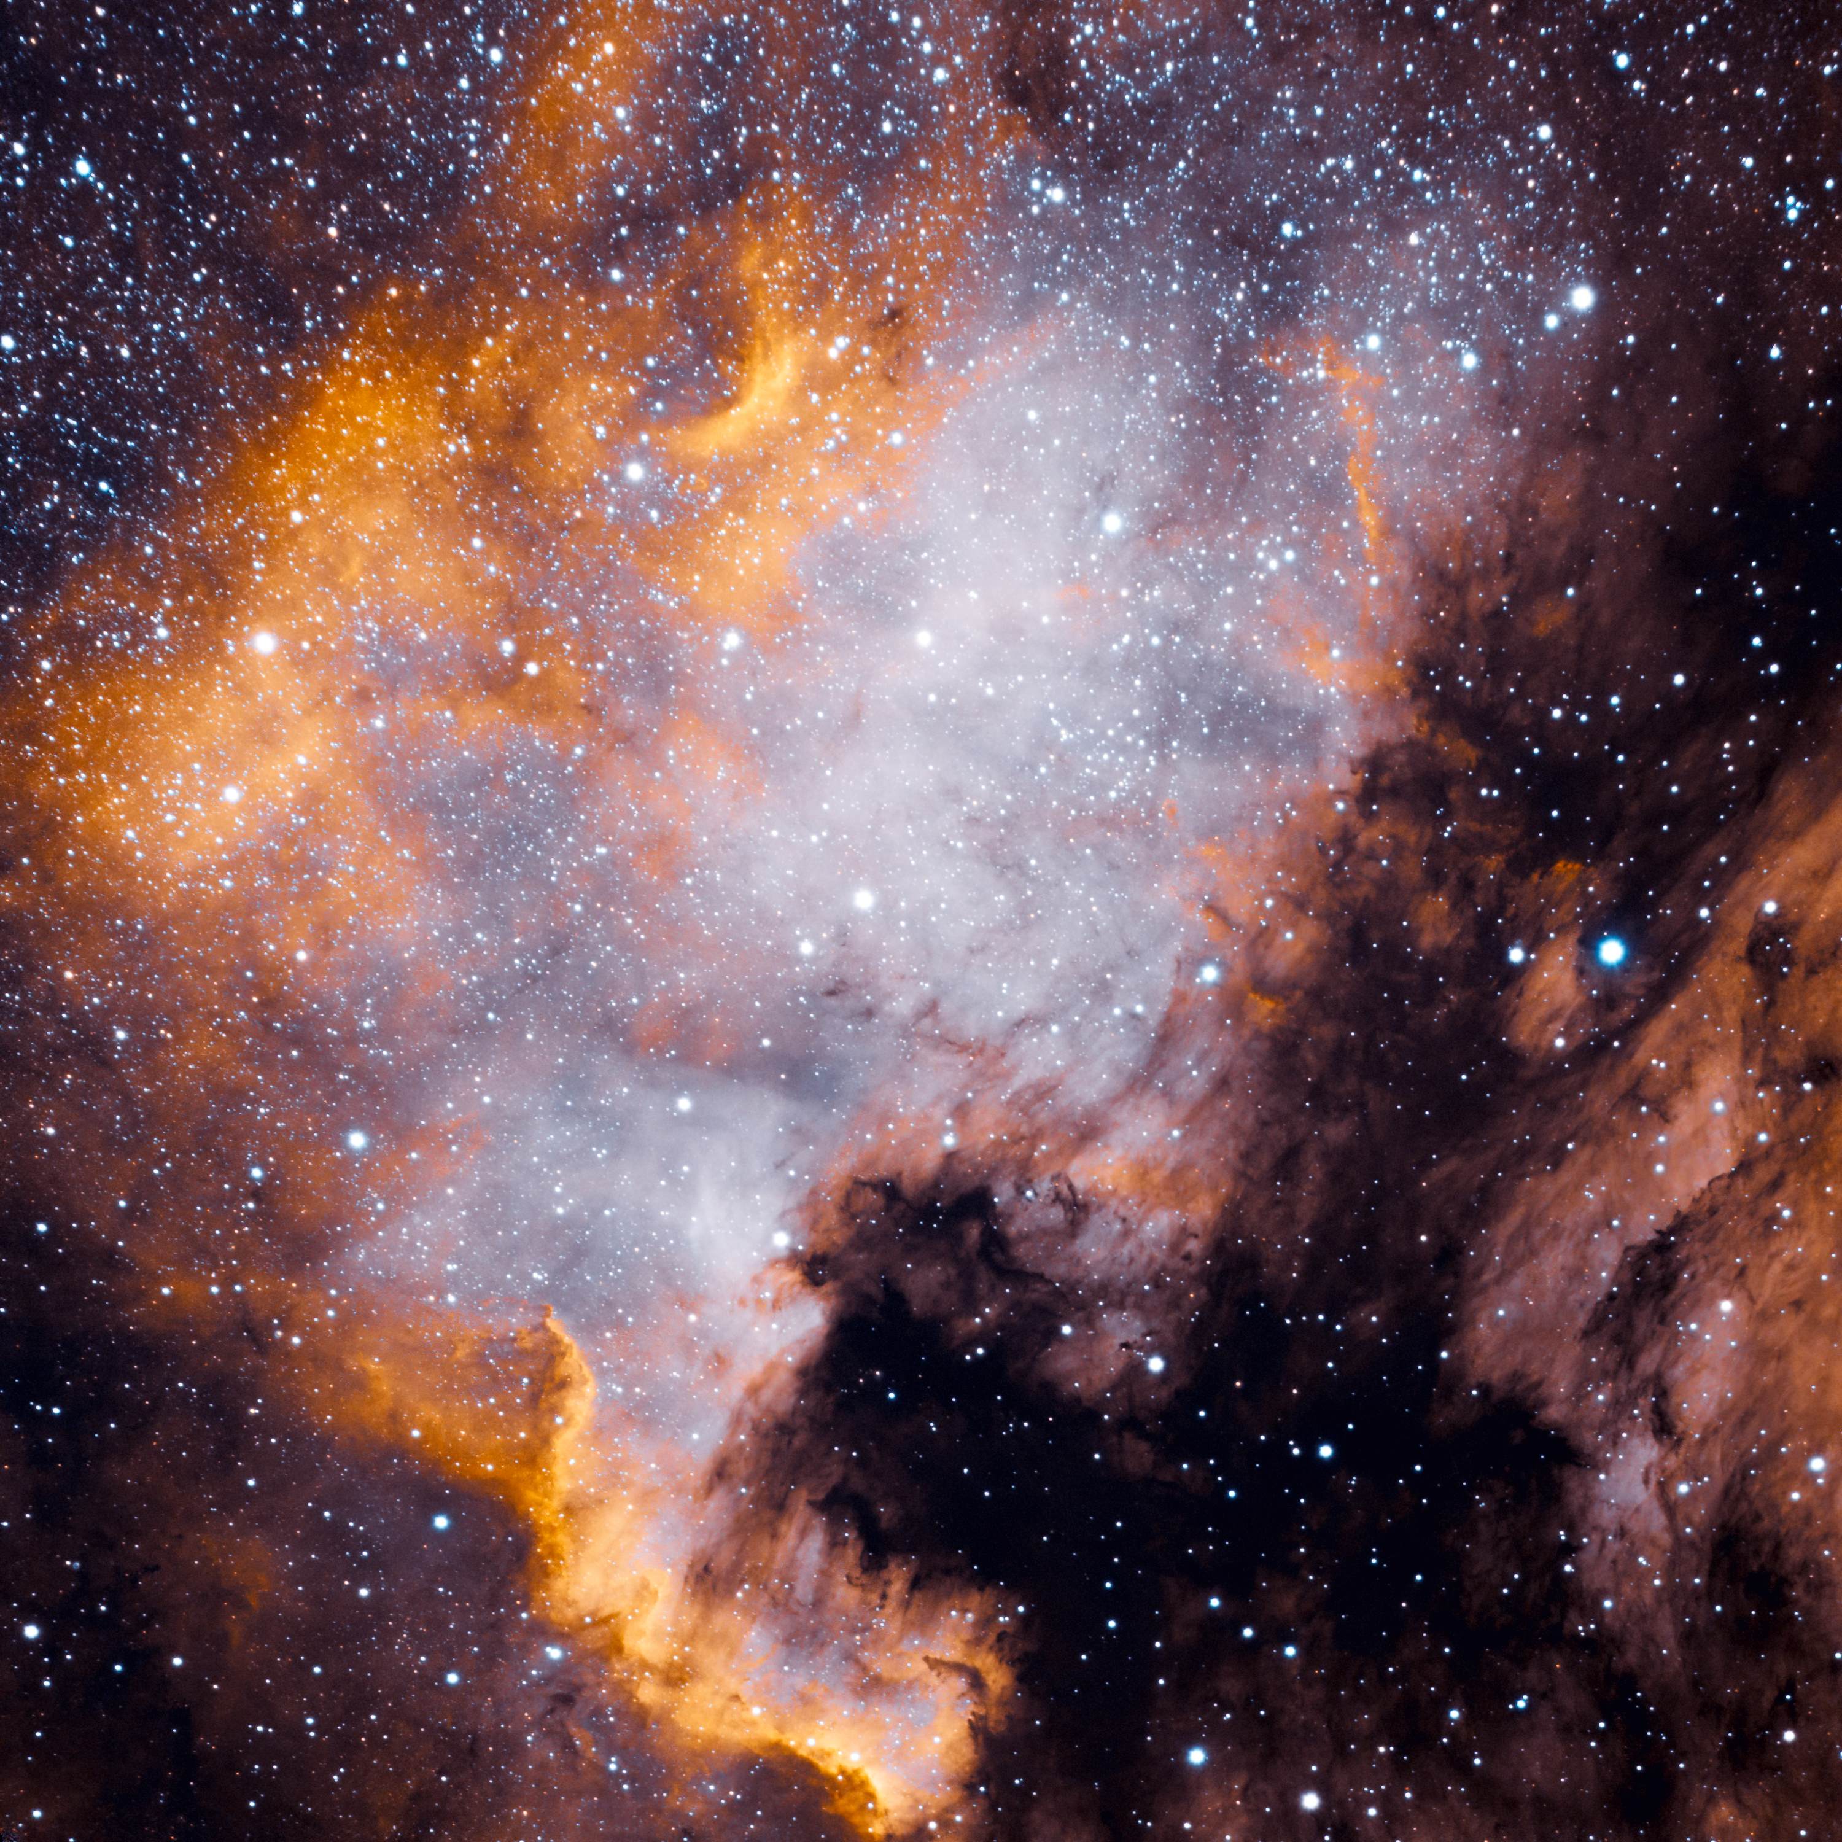
Paul Macklin
My modeling project ideas:
Model fluid flow, couple to cell volume changes
Standardized ECM model, possibly coupling FEbio
My infrastructure / tool ideas:
Standardized interface for reinforcement learning
GUIs for coupling intracellular models
A fun hobby or trivia: Astrophotography, especially nebulas.

